Slide 1



Crown administrators learning pathway to:
Altrua HealthShare
Membership Add-Ons
& Provider Network
This presentation is exclusively for Crown Administrators training purposes only. It is not to be used or distributed outside of this organization.

Slide 2
Presentation Contents
DialCare
Lifeworks
Discount Programs
b.well
Magellan RX
PHCS Provider and Facilities Network

Slide 3



Membership Add-Ons
Altrua HealthShare is pleased to offer membership add-ons at no additional cost to the members.
We provide these offerings and discounts to better assist our members in maintaining a healthy lifestyle and to help members save on out of pocket costs for services and products not eligible for sharing within the Altrua HealthShare membership.

Slide 4
DialCare
Telemedicine Simplified

Slide 5
Telemedicine Overview
DialCare is a modern, easy-to-use telemedicine solution for non-emergency illnesses and general care.
Telemedicine gives our members 24/7 direct access to state licensed and fully credentialed doctors via phone or video consultation, any time day or night, even on holidays or while traveling.
Members can consult with the telemedicine doctors for common ailments such as a cold or even more severe ailments such as a rash or the flu, without ever having to step foot in a doctors office.

Slide 6

What Conditions can be Treated by Telemedicine?
Allergies
Asthma
Bronchitis
Cold & flu
Joint aches & pains
Rashes
Fever
Sore throat
Sports injuries
Respiratory infections
Sinus infections
Skin inflammations
Digestive issues
Gout
Migraines
Insect bites
Pink eye
Ear infections
Urinary tract infections
Stomach ache
Nausea
And more!
This Photo by Unknown Author is licensed under CC BY-SA

Slide 7
Can Telemedicine Doctors Prescribe Medications?
YES! When medically appropriate, a DialCare doctor may prescribe a short term, non-DEA controlled medication. However, prescriptions are not guaranteed. While DialCare doctors can write prescriptions and send them to the members pharmacy of choice, prescriptions are still written at the discretion of the doctor.
Telemedicine doctors do not write prescriptions for DEA controlled substances or other classes of medication such as mood-altering drugs, including antidepressants, antianxiety or lifestyle medications.
This Photo by Unknown Author is licensed under CC BY-SA

Slide 8

When to use DialCare
Members should be encouraged to use DialCare as the first course of action in a non-emergency situation!
For non-emergency medical issues and questions
During or after normal business hours, nights, weekends and holidays
When the member lives a significant distance from a primary care doctor
When a primary care doctor is not available
When traveling, or out of town and in need of non-urgent medical care or advice
This Photo by Unknown Author is licensed under CC BY-NC-ND

Slide 9
Why DialCare and Not the Doctor’s Office?
SAVE MONEY!!! Cost savings to both the member and the membership
Time savings and less time away from work
Avoid long waits in crowded waiting rooms
A private, secure experience
24/7/365 access by phone or video; desktop and mobile devices
National network of U.S. based, licensed and fully credential doctors
This Photo by Unknown Author is licensed under CC BY-NC-ND

Slide 10
DialCare Q. & A.
Q. | A.
Membership Plans | Gold, Silver, Bronze, Copper
Out-of-Pocket Member Cost | There is never any cost to the member to utilize the telemedicine services.
Utilization Limitations | There is unlimited utilization with telemedicine services.
Enrollment | All members of the Gold, Silver, Bronze and Copper memberships are automatically enrolled and eligible to use telemedicine services. There is a dual enrollment application process, meaning members do not need to complete any separate application. Altrua HealthShare will provide the member information to the vendor to have the member’s access set up. There is an approximate two business day turnaround time for this.
Who is Eligible to Use | Altrua HealthShare members of the membership plans above
Special Equipment | Members can connect to a telemedicine physician through phone or computer. To take advantage of the video conference feature, access to a camera is needed. Otherwise, they have the option to just an audio consultation. Rules around when video can be used vary by state, and are controlled by the provider for compliance. Full chat capabilities are also available.

Slide 11
How do Members Access DialCare?
Members are encouraged to access the telemedicine services first through usage of the Altrua HealthShare App
- OR -
They may place a call to (# coming soon)
(Members will dial the same phone number for DialCare, LifeWorks and the Discount Programs. For DialCare, they should select Option 1 for their call to be correctly routed.)
This Photo by Unknown Author is licensed under CC BY-NC-ND

Slide 12
LifeWorks
Helping Individuals Bounce back from Whatever Life Throws at Them

Slide 13
LifeWorks Overview
Available January 1, 2019
LifeWorks is a total well-being platform with a fully integrated set of tools, health assessments, challenges and rewards assisting individuals to make positive lifestyle changes, so they stay healthy both at work and home.
Using the LifeWorks services allows members to gain the knowledge, skills and confidence necessary to reach their personal goals and take charge of their health.

Slide 14

Health Risk Assessment
LifeWorks offers health assessments for individuals that want to evaluate their health risks. Assessments consist of a set of questions that reveal an overview of the person’s current health related to their activity level, alcohol use, eating habits, emotional well-being, sleep, stress level and financial well-being.
This allows individuals to better understand their health risks and make positive lifestyle changes and informed decisions through personalized recommendations, tips and resources.
This Photo by Unknown Author is licensed under CC BY-NC-ND

Slide 15
Health & Wellness Coaching
Stress Management – helps the individual reduce the harmful effects of stress. Coaching is tailored to the individuals preferences and goals.
Weight Management – coaching focuses on lifestyle changes the individual can stick with for life.
Sleep Habit Management – helps individuals identify barriers to getting a good night’s sleep, assists with establishing strategies for overcoming them and creating goals for better sleep habits.
Diabetes Prevention – coaching for individuals that have been diagnosed with high blood sugar levels that are not yet in the diabetic range or those that have concerns about developing diabetes perhaps due to family history or other reasons. This program equips the member with the right prevention tools.
Ask a Coach – coaching to address questions that do not fit into one of the traditional coaching programs – an “outside the box” approach.
This Photo by Unknown Author is licensed under CC BY-NC-ND

Slide 16
Perks and Savings
LifeWorks offers participation driven rewards and incentives!
Participants can save money on daily essentials and treats across 1,200 brands and retailers worldwide
Rewards are unlocked for well-being tier progression towards health goals
Access to discounted digital gift cards that are instant, giving the participant on-the-spot access to discounts whenever, wherever they are
Participants can get cashback every time they shop online
When the amount in the participants LifeWorks Wallet exceeds $5.00, they can transfer it to their PayPal account
This Photo by Unknown Author is licensed under CC BY-NC-ND

Slide 17
LifeWorks Q. & A.
Q. | A.
Membership Plans | Gold, Silver, Bronze, Copper
Out-of-Pocket Member Cost | There is no cost to the member to utilize the LifeWorks offerings.
Enrollment | All members of the Gold, Silver, Bronze and Copper Altrua HealthShare memberships are automatically enrolled and eligible to use LifeWorks services. There is a dual enrollment application process, meaning members do not need to complete any separate application. Altrua HealthShare will provide the member information to the vendor to have the member’s access set up. There is an approximate two business day turnaround time for this.
Who is Eligible to Use | Members and their dependents can utilize LifeWorks offerings. (dependents do not need to be members of Altrua HealthShare)
Utilization Limitations | Counseling is limited to a maximum of five visits per issue. After depleting the five allowed visits (at no cost) for that issue, individuals may continue counseling at a LifeWorks negotiated rate with the provider that the member is responsible for paying. There is no limit to the number of issues the member may receive counseling for. This means that an individual can have (without charge) up to five visits for depression, five visits for marriage counseling, etc.
Prescriptions | Prescriptions will not given with this platform.

Slide 18

How do Members Access LifeWorks?
Members may visit the LifeWorks website at www.lifeworks.com/us/
(additional website information coming soon)
- OR -
They may place a call to
(# coming soon)
(Members will dial the same phone number for DialCare, LifeWorks and the Discount Programs. For LifeWorks, they should select Option 2 for their call to be correctly routed.)
This Photo by Unknown Author is licensed under CC BY-NC-ND

Slide 19
Discount Programs
Discounts on vision, dental, hearing and much more!

Slide 20
Discount Programs Overview
Effective January 1, 2019, all members of the Gold, Silver, Bronze and Copper memberships will be automatically enrolled in the Discount Programs, AT NO COST … And no application is needed!
(The Discount Programs were formerly referred to as The Healthy Living Plan, with less benefits.)
The Discount Programs deliver some of the industry’s deepest discounts and provides members more control of their health care and lifestyle spending.

Slide 21

Discount Programs Overview
Complements the Altrua HealthShare membership
Nationwide access to providers
Discounts available at the time of service
Immediate value
No limits on usage
No administrative forms to file

Slide 22
Discount Programs Highlights
Careington POS Series Dental Network provides one of the most recognized professional dental network with savings of 20% - 50%
EPIC Hearing provides access to hearing aid discounts of 30% - 60% through 5,000 participating providers nationwide. This program includes a complete hearing evaluation FREE
Quest Diagnostics Lab Card Program saves approximately 30% - 60% on outpatient laboratory testing, and allows members to receive testing with no out-of-pocket cost when they use Quest Diagnostics
US Imaging is a premier diagnostic scheduling service that provides members with savings from 10% to 60% on advanced imaging procedures at over 2,400 radiology facilities nationwide
Choose Healthy provides access to a wide variety of specialty health care services including chiropractors, massage therapists, acupuncturists and dieticians. Also includes fitness club discounts

Slide 23
Discount Programs Highlights
HomeLink, a leader in durable medical supplies, has over 32,000 provider and manufacturer relationships, ensuring that quality, savings and excellence are always available to you no matter what your medical needs are
Better Living Now includes a free glucose monitor upgrade and discounts on durable medical equipment, disposable medical supplies, nutritional supplements and daily living aids
Superior Vision provides access to over 40,000 participating providers offering members with saving of 5% to 30% on eye exams, glasses, and contact lenses
QualSight provides members with savings of 40% to 50% off the overall national average cost for Traditional LASIK surgery through QualSight or members can receive significant savings on newer procedures like Custom Bladeless (all laser) LASIK
QualSight has more than 1,000 locations, so members can choose the provider and the LASIK procedure that meet their vision care needs
QualSight is contracted with credentialed and experienced providers who have collectively performed over 7 million procedures
DialCare (refer to the DialCare section of this presentation)
LifeWorks (refer to the LifeWorks section of this presentation)

Slide 24
How Do the Discount Programs Work?
Discount information will be available through the Altrua HealthShare App, and on the Member ID card
The Discount Programs do not pay providers directly
Plan members must pay for all services but will receive a discount from participating providers

Slide 25
Discount Programs Q. & A.
Q. | A.
Membership Plans | Gold, Silver, Bronze and Copper
Out-of-Pocket Member Cost | There is no cost to the member to use the discounts offered.
Utilization Limitations | There is unlimited utilization of discounts offered by the Discount Programs.
Enrollment | All members of the Gold, Silver, Bronze and Copper memberships are automatically enrolled and eligible for discounts offered by the Discount Programs. There is a dual enrollment application process, meaning members do not need to complete any separate application. Altrua HealthShare will provide the member information to the vendor to have the member’s access set up. There is an approximate two business day turnaround time for this.
Who is Eligible to Use | Altrua HealthShare members of the membership plans above

Slide 26
How do Members Access the Discount Programs?
Members may simply present their Member ID card, or the Altrua HealthShare App upon receiving services, and the vendor will process any qualifying discounts
Members may visit the Careington website at: www.careington.com
To reach a representative with Careington members may call them directly at 1.800.411.0380
OR –
They may place a call to
(# coming soon)
(Members will dial the same phone number for DialCare, LifeWorks and the Discount Programs. For the Discount Programs, they should select Option 3 for their call to be correctly routed.)

Slide 27
Altrua HealthShare App
A personalized health management system

Slide 28
Altrua HealthShare App Overview
The Altrua HealthShare App is scheduled to launch January 1, 2019!
More information coming soon … the following slides contain a few highlights and sample screen shots

Slide 29

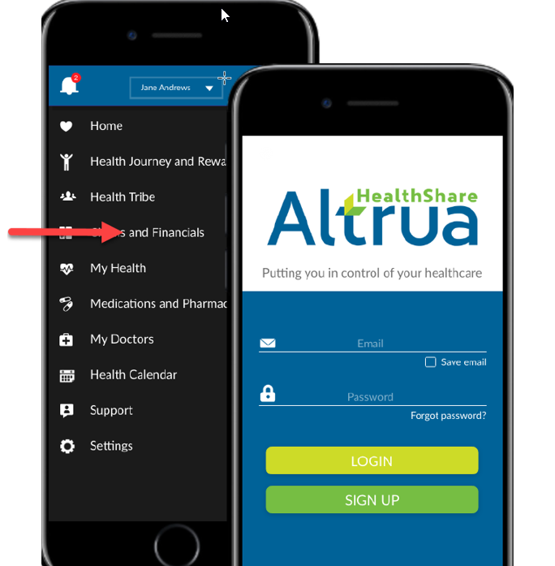
Altrua HealthShare App

Slide 30
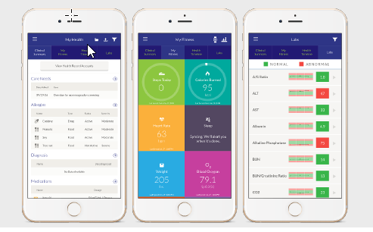
Altrua HealthShare App Sample screen shots
Personal Health Record

Slide 31
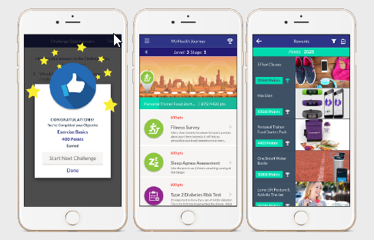
Altrua HealthShare App Sample Screen Shots
Personal Health Journey

Slide 32
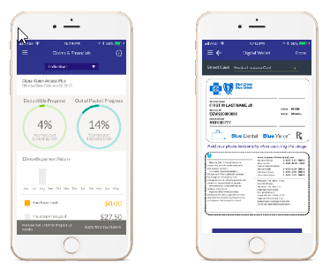
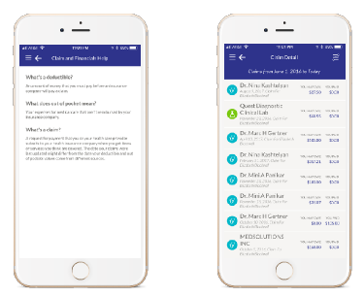
Altrua HealthShare App Sample Screen Shots
Digital Health
Wallet

Slide 33
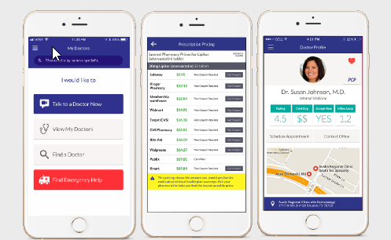
Altrua HealthShare App Sample Screen Shots
Personal Health Services

Slide 34
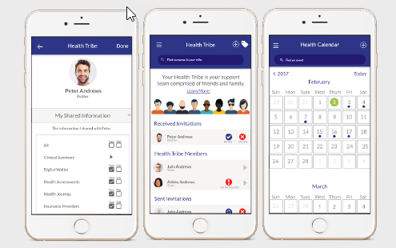
Altrua HealthShare App Sample Screen Shots
Health Tribe

Slide 35
Altrua HealthShare App Highlights
Nutrition Programs
Fitness & Physical Activity Programs
Medication Delivery Services
Medication Management Services
Lifestyle & Clinical Coaching Programs
Mindfulness Programs
Stress & Anxiety Management Programs
Kids Health Programs
Virtual Primary Care Programs
Charitable Giving Programs
Home Monitoring Programs
Physician Home Visit Programs
Integrative Medicine/Precision Medicine Programs
Chronic Condition Management Programs
Sleep Management Programs

Slide 36
Magellan RX
Prescription Discount Program

Slide 37

Magellan RX Overview
Altrua HealthShare has partnered with Magellan RX to provide a Generic and Name Brand discount program to its members for prescribed medications.
With the Magellan RX discount, prescriptions are discounted up to 79%!

Slide 38
Magellan RX Q. & A.
Q. | A.
Membership Plans | Gold, Silver, Bronze, Copper, Select Silver, Gold Plus & Bronze Plus
Out-of-Pocket Member Cost | There is no cost to the member to utilize the prescription discounts
Enrollment | Members are automatically eligible to take advantage of the prescription drug discounts
Who is Eligible to Use | All members of Altrua HealthShare
Prescriptions | Not all prescriptions are eligible for discount. Over the counter medications are not eligible for discount, and medications that are contrary to the Statement of Standards and Membership Guidelines are not eligible for discount through Magellan RX.

Slide 39

How do Members Access the Prescription Drug Discount?
Members may simply present their Member ID card, or the Altrua HealthShare App at their pharmacy of choice, and the pharmacy will process any qualifying discounts
Members may also visit the Magellan RX website at: www1.magellanrx.com/magellan-rx
- OR -
To reach a representative with Magellan RX members may call 1.800.424.0472
This Photo by Unknown Author is licensed under CC BY-ND

Slide 40
PHCS
Network of
Providers and Facilities

Slide 41
PHCS Providers and Facilities Network Overview
Effective January 1, 2019, Altrua HealthShare will change from using the PHCS Practitioner Only Network to the full PHCS Network of Practitioners and Facilities.
Altrua HealthShare has joined the PHCS Network so that we can share needs all across the nation.

Slide 42

PHCS Network Overview
To help members get the most out of sharing, Altrua HealthShare uses an affiliated network of providers
Affiliated providers are providers that have agreed to discount their services to a contracted rate.

Slide 43
Benefits of Using a PHCS Provider or Facility
Benefits to the Member
Members benefit with significant savings from lowered MRAs
Benefits to the Membership
The membership benefits with the significantly lowered sharing amounts from the Escrow Account when processing eligible medical needs

Slide 44
How do Members Locate a PHCS Provider or Facility or Verify if their Provider is Affiliated?
Members may locate an affiliated provider by going to:
www.altruahealthshare.org/resources/affiliated-providers
OR –
They may contact the Provider Affiliation Department at 1.888.244.3839

Slide 45
Thank you for attending the:
Altrua HealthShare
Membership Add-Ons
and Provider Network Training
This presentation is exclusively for Crown Administrators training purposes only. It is not to be used or distributed outside of this organization.

